Slide 1

Amazon’s Recommender System

Slide 2
What Are Recommendation Systems
Recommendation system is an extensive class of web applications that involve predicting user responses to options.
They help users discover content based on their unique needs and preferences
In the case of amazon, offering customers things that they might like to buy based on their history of purchases and/or product searches
A recommender system learns from customer and recommends product or information that they will find valuable
These systems can bring up to 30% additional revenue
Notes:
Recommendation system is an extensive class of web applications that involve predicting user responses to options.
They help users discover content based on their unique needs and preferences
In the case of amazon, offering customers things that they might like to buy based on their history of purchases and/or product searches
A recommender system learns from customer and recommends product or information that they will find valuable
These systems can bring up to 30% additional revenue

Slide 3
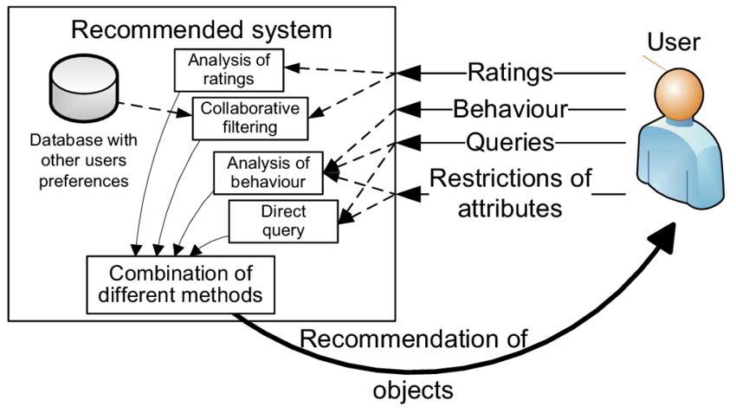
How Do These Systems Work?
These systems enable marketers to prioritize their spend and enable them to understand how consumers behave.
Popular methods of recommendation systems include collaborative filtering (based on interest of users), content-based filtering(based on similar content) and hybrid content-based collaborative filtering
Notes:
These systems enable marketers to prioritize their spend and enable them to understand how consumers behave.
It’s a filter to narrow down a list of available options to help users find relevant products
Difference between search engine and recommendation engine, recommendation system will predict and identify your specific taste for recommendations
Popular methods of recommendation systems include collaborative filtering (based on interest of users), content-based filtering(based on similar content) and hybrid content-based collaborative filtering

Slide 4

Market Drivers
E commerce sales will top 4 trillion by the end of 2020, and with the events like covid, companies are very motivated to have some sort of e commerce buffer whether its through amazon, shopify, or their own platform to be able to stay strong
Notes:
E commerce sales will top 4 trillion by the end of 2020, and with the events like covid, companies are very motivated to have some sort of e commerce buffer whether its through amazon, shopify, or their own platform to be able to stay strong
Amazon interface
Customers who bought things recommendation interface is similar item, technology is item to item correlation, presentation is based on organic navigation.
For their book matcher, they use their top N list for interface, people to people correlations.
Ebay on the other hand uses average rating and aggregated ratings for recommendations
This goes to show there is no one single solution for these

Slide 5
Amazon – Gold standard
In 2015 amazon surpassed Walmart as the most valuable retailer in the united states by market cap has revenues upwards of 100 billion
Non-personal recommendations
At the front of amazons home page, they offer reccomendations about collective preferences. These are based on popular items in local areas, while also taking into consideration time viewing an item and number of times purchased
As someone begins browsing, the engine start to determine person’s preferences and leverages this information accordingly
Notes:
In 2015 amazon surpassed Walmart as the most valuable retailer in the united states by market cap has revenues upwards of 100 billion
Non-personal recommendations
At the front of amazons home page, they offer reccomendations about collective preferences. These are based on popular items in local areas, while also taking into consideration time viewing an item and number of times purchased
As someone begins browsing, the engine start to determine person’s preferences and leverages this information accordingly

Slide 6
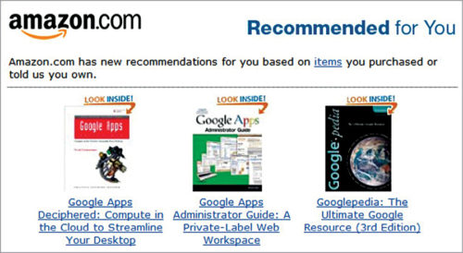
Final Notes
Once amazon has enough information about you they will switch to collaborative filtering and recommends items
Amazon uses weighting process to combine similar lists representing relative importance of popular items with respect to other items of known interest.
Weighting scheme of similar item lists:
Rating of the user to popular item
Time user spend on popular item
Recent purchasing items are weighted more than earlier purchasing items
Popular items are based on:
Number of page views on an item
Time on an item
Bounce rate of an item and
Exit rate of that item
Notes:
Once amazon has enough information about you they will switch to collaborative filtering and recommends items
Amazon uses weighting process to combine similar lists representing relative importance of popular items with respect to other items of known interest.
Weighting scheme of similar item lists:
Rating of the user to popular item
Time user spend on popular item
Recent purchasing items are weighted more than earlier purchasing items
Popular items are based on:
Number of page views on an item
Time on an item
Bounce rate of an item and
Exit rate of that item

